Slide 1
Internet Of Things
Beginning of New Era
Presented By:
Suraj Choudhary
Unrestricted
Notes:
https://www.youtube.com/watch?v=nEVatZruJ7k&feature=youtu.be

Slide 2
Various Names, One Concept
M2M (Machine to Machine)
“Internet of Everything” (Cisco Systems)
“World Size Web” (Bruce Schneier)
“Skynet” (Terminator movie)
Notes:
British entrepreneur Kevin Ashton first coined the term in 1999 while working at Auto-ID Labs (originally called Auto-ID centers - referring to a global network of Radio-frequency identification (RFID) connected objects).[10] Typically, IoT is expected to offer advanced connectivity of devices, systems, and services that goes beyond machine-to-machine communications (M2M) and covers a variety of protocols, domains, and applications.[11] The interconnection of these embedded devices (including smart objects), is expected to usher in automation in nearly all fields, while also enabling advanced applications like a Smart Grid,[12] and expanding to the areas such as smart cities.
Cisco Systems refers to IoT as the “Internet of Everything”…
Bruce Schinerer recently referred to two new colloquial terms – World Spanning Robot and Benign Organization. There is also the term “Skynet” in reference to the Terminator movies that is frequently discussed in Blog and online postings/jargon.

Slide 3
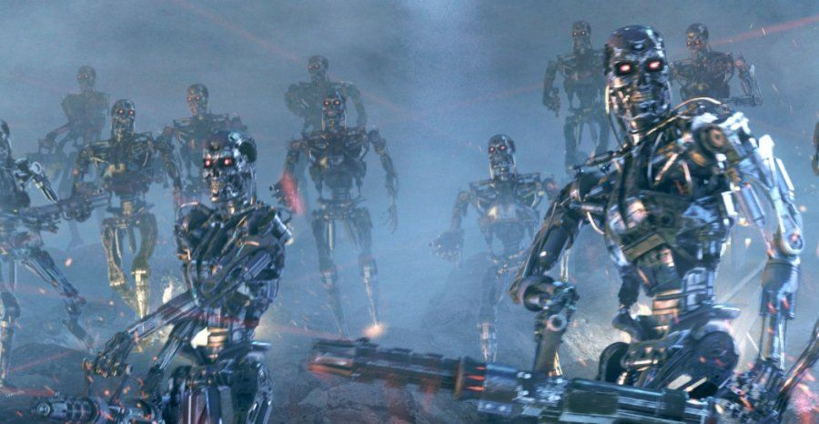
2020: World with Terminators…

Slide 4
Where is IoT?
Lets understand it…

Slide 5
What is IOT?
https://www.forbes.com/sites/gilpress/2014/08/22/internet-of-things-by-the-numbers-market-estimates-and-forecasts/#44bbc9eeb919
https://www.youtube.com/watch?v=QSIPNhOiMoE

Slide 6
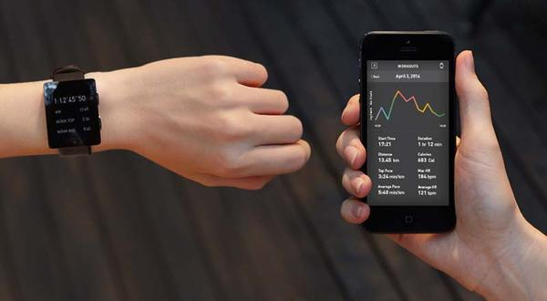
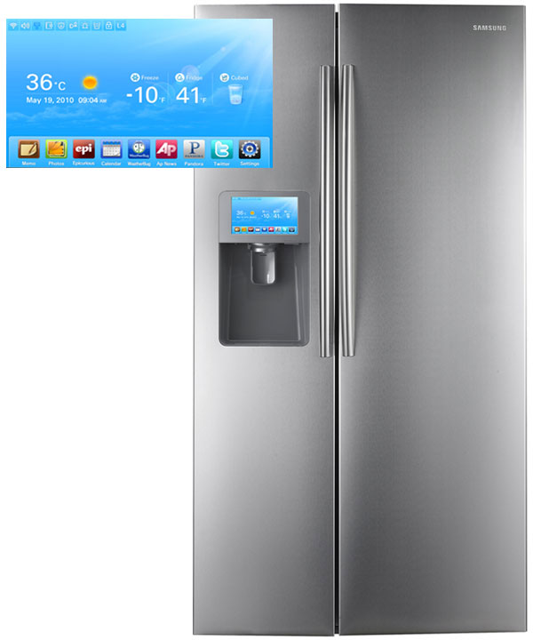
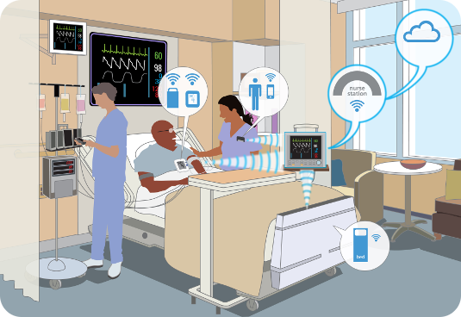
IOT in Day To Day Life
Smart Appliances
Wearable Tech
Healthcare

Slide 7
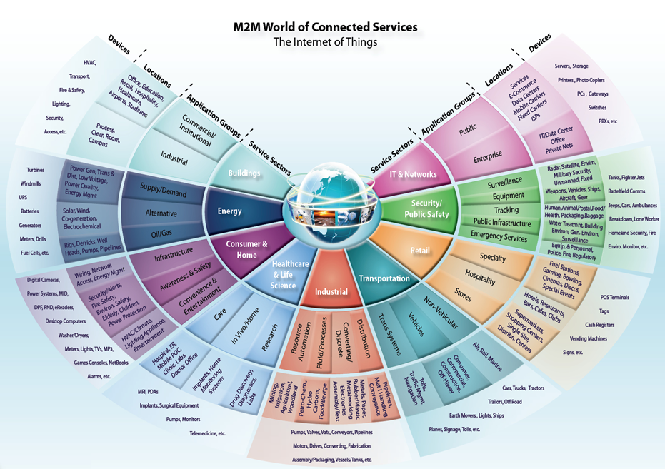

Slide 8
What’s the Internet of Things
Definition
(1) The Internet of Things, also called The Internet of Objects, refers to a wireless network between objects, usually the network will be wireless and self-configuring, such as household appliances.
------Wikipedia
(2) By embedding short-range mobile transceivers into a wide array of additional gadgets and everyday items, enabling new forms of communication between people and things, and between things themselves.
------WSIS 2005
Notes:
WSIS: World Summit on the Information Society, it’s a pair of conference about information society

Slide 9
What’s the Internet of Things
Definition
(3) The term "Internet of Things" has come to describe a number of technologies and research disciplines that enable the Internet to reach out into the real world of physical objects.
------IoT 2008
(4) “Things having identities and virtual personalities operating in smart spaces using intelligent interfaces to connect and communicate within social, environmental, and user contexts”.
-------IoT in 2020
Notes:
The semantic origin of the expression is composed by two words and concepts: “Internet” and “Thing”, where “Internet” can be defined as “The world-wide network of interconnected computer networks, based on a standard communication protocol, the Internet suite (TCP/IP)”, while “Thing” is “an object not precisely identifiable” Therefore, semantically, “Internet of Things” means “a world-wide network of interconnected objects uniquely addressable, based on standard

Slide 10
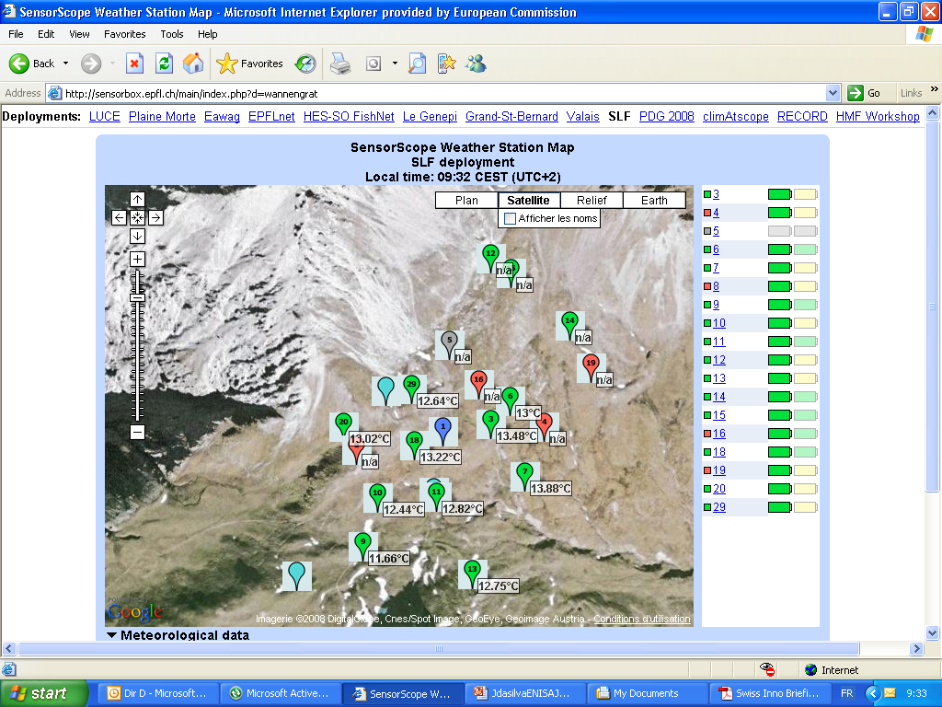
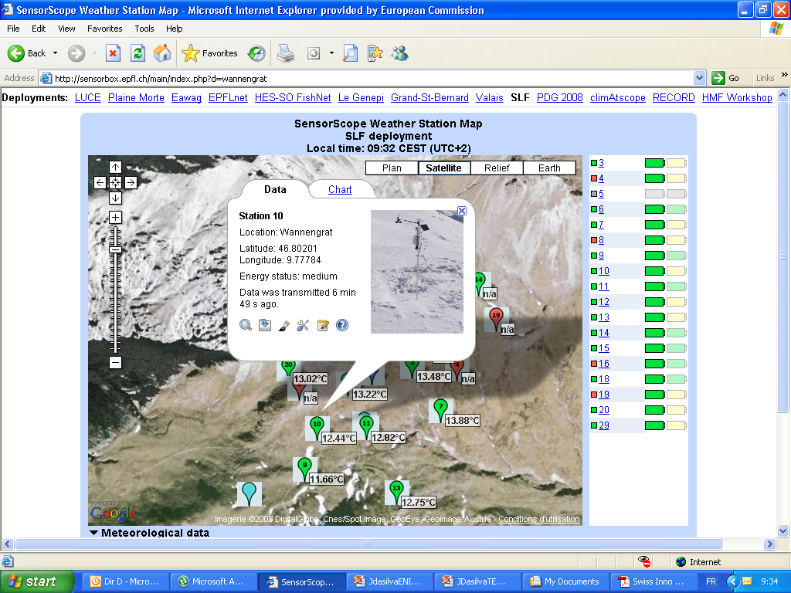
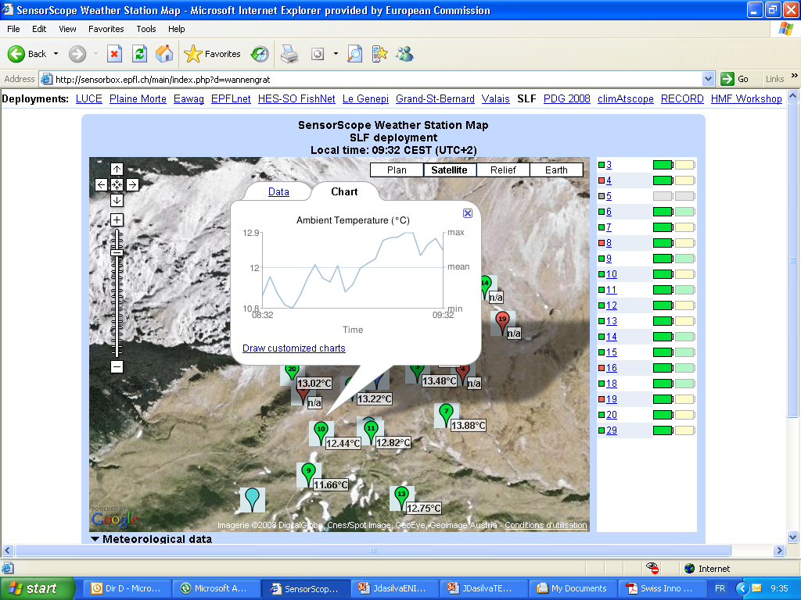
Scenario : Monitoring the Environment
The Application of IoT

Slide 11
IoT and WSN
× WSN is IoT √ IoT has WSN
√ IoT is not WSN ➔ IoT ≠WSN
√ IoT contains WSN ➔ IoT ≥WSN
Notes:
在需要配一张图（另一张PPT）？

Slide 12
IoT and WSN
Things are diverse
They might be individual like water, soldiers, trees…
They also be a set of individuals like ocean, battlefield, forest, …
Notes:
嵌入化（embedded）
传感器是一种物理装置或生物器官，能够探测、感受外界的信号、物理条件(如光、热、湿度)或化学组成(如烟雾)，并将探知的信息传递给其他装置或器官。如果把物联网比作人，那么传感器就像人体的五官。
数据化（data-intensive）：
美国曾预测，到2020年，物联网业务量与人与人之间的通信业务量相比，将是30：1的差距。
在这个整合的网络当中，存在能力超级强大的中心计算机群，能够对整合网络内的人员、机器、设备和基础设施实施实时的管理和控制。

Slide 13

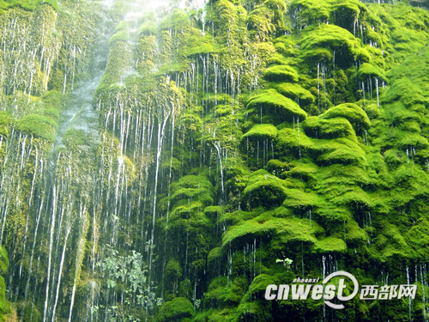
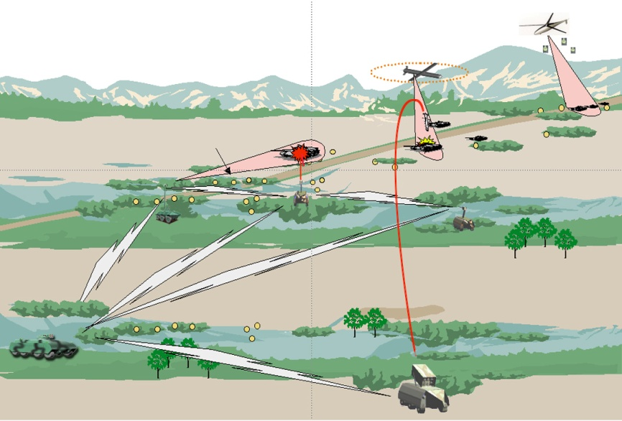
IoT and WSN
We concern not only about water, tree and soldier, but also about ocean, forest and battlefield.
Notes:
嵌入化（embedded）
传感器是一种物理装置或生物器官，能够探测、感受外界的信号、物理条件(如光、热、湿度)或化学组成(如烟雾)，并将探知的信息传递给其他装置或器官。如果把物联网比作人，那么传感器就像人体的五官。
数据化（data-intensive）：
美国曾预测，到2020年，物联网业务量与人与人之间的通信业务量相比，将是30：1的差距。
在这个整合的网络当中，存在能力超级强大的中心计算机群，能够对整合网络内的人员、机器、设备和基础设施实施实时的管理和控制。

Slide 14
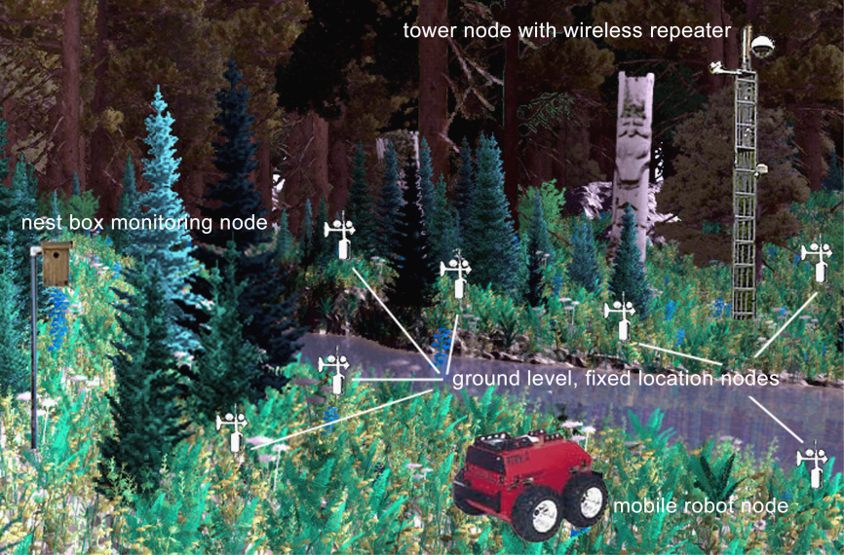
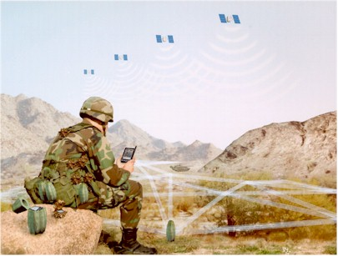
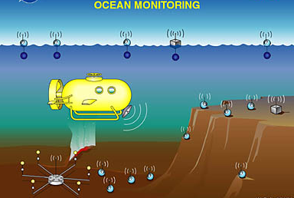
IoT and WSN
So we have ocean monitoring, Forest management, battlefield control.

Slide 15
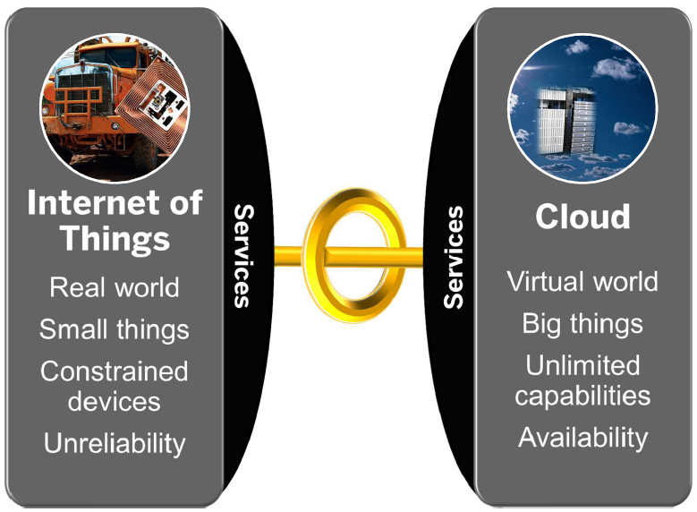
Internet of Things vs. Cloud Properties

Slide 16
4 Layers Model for IoT
Information Application
Integrated Application Layer
Information Processing
Management Layer
Information Transmission
Network Construction Layer
Information Generation
Sense and Identification Layer

Slide 17
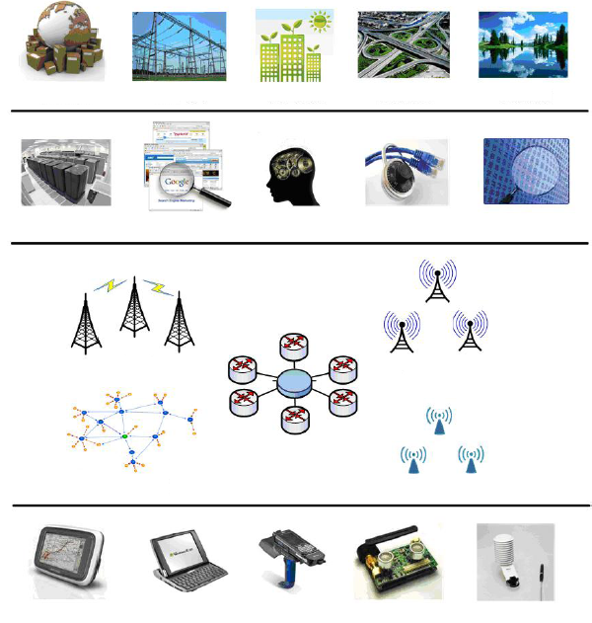
More on 4 Layers Model
Integrated Application
Smart Logistic
Smart Grid
Green Building
Smart Transport
Env. Monitor
Information Processing
Data Center
Search Engine
Smart Decision
Info. Security
Data Mining
Network Construction
WWAN
WMAN
Internet
WPAN
WLAN
Sensing and Identification
GPS
Smart Device
RFID
Sensor
Sensor

Slide 18
To being with…
You need a device (can be machine/hardware/cloud)
You need network to connect (intranet/internet)
You need power (power supply)
You need IOT stack/firmware.
What is this??
Do I need to write it?
IOT STACK
Can I get it readily available?
How to start with?

Slide 19
Data Protocols
MQTT (Message Queuing Telemetry Transport) "The MQTT protocol enables a publish/subscribe messaging model in an extremely lightweight way. It is useful for connections with remote locations where a small code footprint is required and/or network bandwidth is at a premium."
-MQTT-SN (MQTT For Sensor Networks) - An open and lightweight publish/subscribe protocol designed specifically for machine-to-machine and mobile applications
-Mosquitto: An Open Source MQTT v3.1 Broker
CoAP (Constrained Application Protocol) "CoAP is an application layer protocol that is intended for use in resource-constrained internet devices, such as WSN nodes. CoAP is designed to easily translate to HTTP for simplified integration with the web, while also meeting specialized requirements such as multicast support, very low overhead, and simplicity. The CoRE group has proposed the following features for CoAP: RESTful protocol design minimizing the complexity of mapping with HTTP, Low header overhead and parsing complexity, URI and content-type support, Support for the discovery of resources provided by known CoAP services. Simple subscription for a resource, and resulting push notifications, Simple caching based on max-age."
SMCP — A C-based CoAP stack which is suitable for embedded environments. Features include: Support draft-ietf-core-coap-13, Fully asynchronous I/O, Supports both BSD sockets and UIP.
XMPP (Extensible Messaging and Presence Protocol)

Slide 20
Data Protocols
XMPP-IoT
Mihini/M3DA
AMQP (Advanced Message Queuing Protocol) DDS (Data-Distribution Service for Real-Time Systems)
JMS (Java Message Service)
LLAP (lightweight local automation protocol)
SSI (Simple Sensor Interface)
Reactive Streams
ONS 2.0 REST (Representational state transfer) - RESTful HTTP SOAP (Simple Object Access Protocol), JSON/XML, WebHooks, Jelastic, MongoDB Websocket

Slide 21

What is this Blaa Blaa going On??
How can I connect my Device to Internet?
Do I really need it?
Where Can I get this Cloud stuff?
What Hardware Do I Need?
Where can I send Data???
What kind of Data I can Send?

Slide 22
Existing IoT platforms /middleware
IoT- A -> http://www.iot-a.eu/public
Hydra -> http://www.hydramiddleware.eu/news.php
OpenIOT -> http://www.openiot.eu/
Carriot -> https://www.carriots.com/
Xively -> https://www.xively.com/
etc ->
Notes:
http://www.iot-a.eu/public
https://github.com/OpenIotOrg/openiot
https://www.carriots.com/
https://www.xively.com/

Slide 23
Agenda
DIY Create you own web server. (2 sessions)
Introduction to node js and Java script
Introduction to IAAS and PAAS.
Host your first website.
Understanding Hardware and protocols. (3 sessions)
Raspberry Pi
Introduction to RPI
Different ways of programming in RPI
Control GPIO on RPI
Introduction to MQTT (IOT protocol)
Sending and Receiving messages on MQTT
DIY Control your device over internet. (4 Sessions)
Implementing MQTT services at server side.
Creating basic GUI (web pages with buttons/controls)
Controlling devices (Bulb/Fan/etc) using MQTT over internet.

Slide 24
Demo 1
Web server
Mqtt broker
Publisher
Cloud
RPI
Subscriber

Slide 25


